Slide 1
Energy Bidding Optimization
MTHE 493
Group 13
Thomas Boyle, Natalie Chow, Sam Joffe, Rohan Kumar
April 7th, 2026

Slide 2
Problem definition

Slide 3

PROJECT OVERVIEW
Formal Problem Statement
Develop a model that uses Enverus’ proprietary datasets to optimize strategies in the energy-market bidding landscape by integrating machine learning and game theory
Our Partner: Enverus, An energy data and analytics company that provides information for participants in North American electricity and commodity markets.

Slide 4
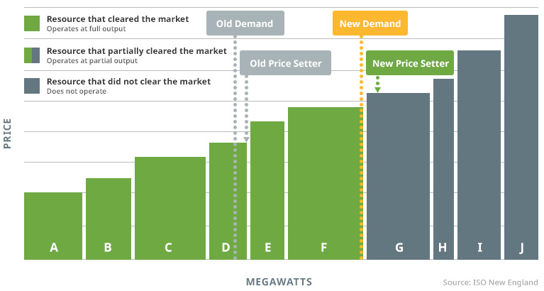

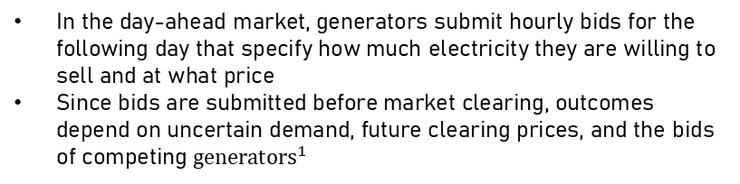
MARKET BACKGROUND
Market Overview
Market Clearing Process
In the day-ahead market, generators submit hourly bids for the following day that specify how much electricity they are willing to sell and at what price
Since bids are submitted before market clearing, outcomes depend on uncertain demand, future clearing prices, and the bids of competing ${generators}^{1}$
Generator
Submit Bid
Supply ${Stack}^{1}$
Market Clears
Cleared or Not Cleared
Profit Outcome

Slide 5

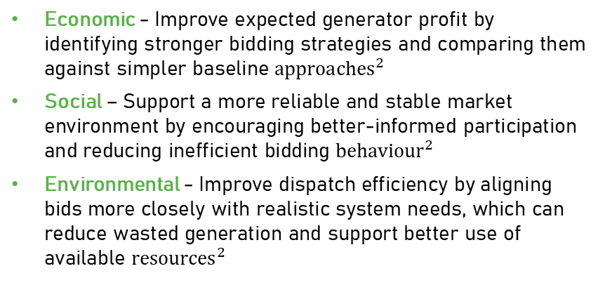
Problem Definition AND TBL
Problem Definition
Stakeholders
“
Electricity market bidding involves uncertainty, strategic competition, and changing market conditions, making it difficult to design bidding strategies that are both profitable and reliable.
”
Enverus
Power Plants
ISO/Consumers
Triple Bottom Line
Decision/Problem Setting
Economic - Improve expected generator profit by identifying stronger bidding strategies and comparing them against simpler baseline ${approaches}^{2}$
Social – Support a more reliable and stable market environment by encouraging better-informed participation and reducing inefficient bidding ${behaviour}^{2}$
Environmental - Improve dispatch efficiency by aligning bids more closely with realistic system needs, which can reduce wasted generation and support better use of available ${resources}^{2}$
Bid Quantity
Bid Price
Hourly Timing
Forecasted Demand
Competitor Behaviour
Market Supply Stack

Slide 6
Success Criteria

Slide 7
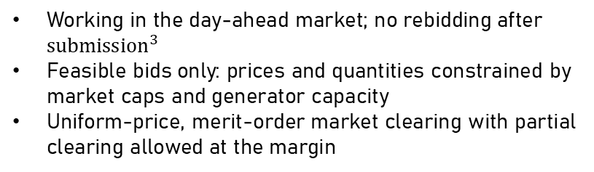
Solution Constraints and requirements
Operational & Market Rules
Agent Information Constraints
Working in the day-ahead market; no rebidding after ${submission}^{3}$
Feasible bids only: prices and quantities constrained by market caps and generator capacity
Uniform‑price, merit‑order market clearing with partial clearing allowed at the margin
Information Available at Bid Time
Historical prices and loads
Day-ahead load forecasts
Past clearing outcomes
Information Not Available
Policy Performance Metrics
Future clearing prices
Competitor bids
Realized demand shocks
Quantitative measures used to evaluate how well the learned bidding policy performs
Mean episode reward
Profit share
Realism & Robustness Requirements
Penalizes overly aggressive bids through realized profit variance
Avoids strategies that maximize clearing at the cost of negative margins
Emphasizes stable expected returns over volatility
Reward variance
Action entropy
Win rate

Slide 8
Model Design

Slide 9
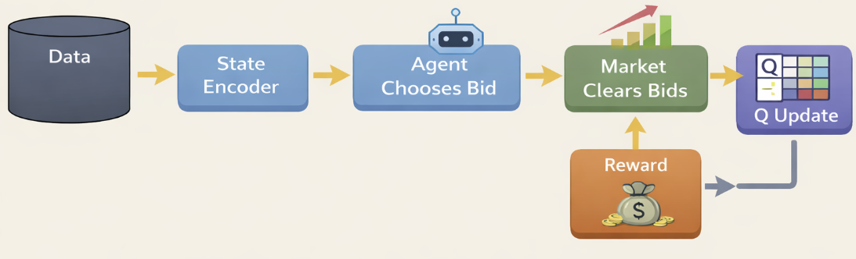
Design Approach
Goal: Train bidding agents that maximize profit in a realistic market simulation.
Why RL + Simulation?
Strategic, repeated bidding problem where agents learn through interaction
No safe or inexpensive way to test policies directly in the real market
Simulation allows controlled what-if testing, such as demand shocks and freeze scenarios
Modeling Choices:
Agent: Tabular Q-learning bidding agents
State: Discretized market context, including price, load, load forecast, and time features
Action: Discrete bid (price, quantity) selected from an action grid
Reward: Profit using sampled marginal cost
Environment: Multi-agent residual-demand market clearing
Notes:
The goal of our project is to train bidding agents to maximize profit in a realistic electricity market simulation.
We chose a reinforcement learning plus simulation based approach for three main reasons. The first is that electricity market bidding is a strategic, repeated problem where agents need to learn through interaction, not just optimization. Second, there's no way to safely test policies directly in the real market, so simulation gives us a controlled environment. Third, simulation lets us run what-if scenarios, like demand shocks or policy freezes, that we couldn't otherwise test.
In terms of modeling choices, our agents are tabular Q-learning bidding agents. The state they observe is discretized and includes historical price and load, load forecast, and time of day. At each step, the agent selects a bid which is a price and quantity pair from a finite action grid. The reward is profit, which is calculated using a sampled marginal cost. And the environment itself is a multi-agent residual-demand market clearing model, this means our agents are competing against a realistic supply stack of opponents.
As shown in the diagram, the pipeline flows from raw data through a state encoder, to the agent choosing a bid, to the market clearing those bids and producing a reward, which then feeds back into the Q-table update. This loop repeats across hundreds of episodes until the agents converge on profitable bidding strategies

Slide 10
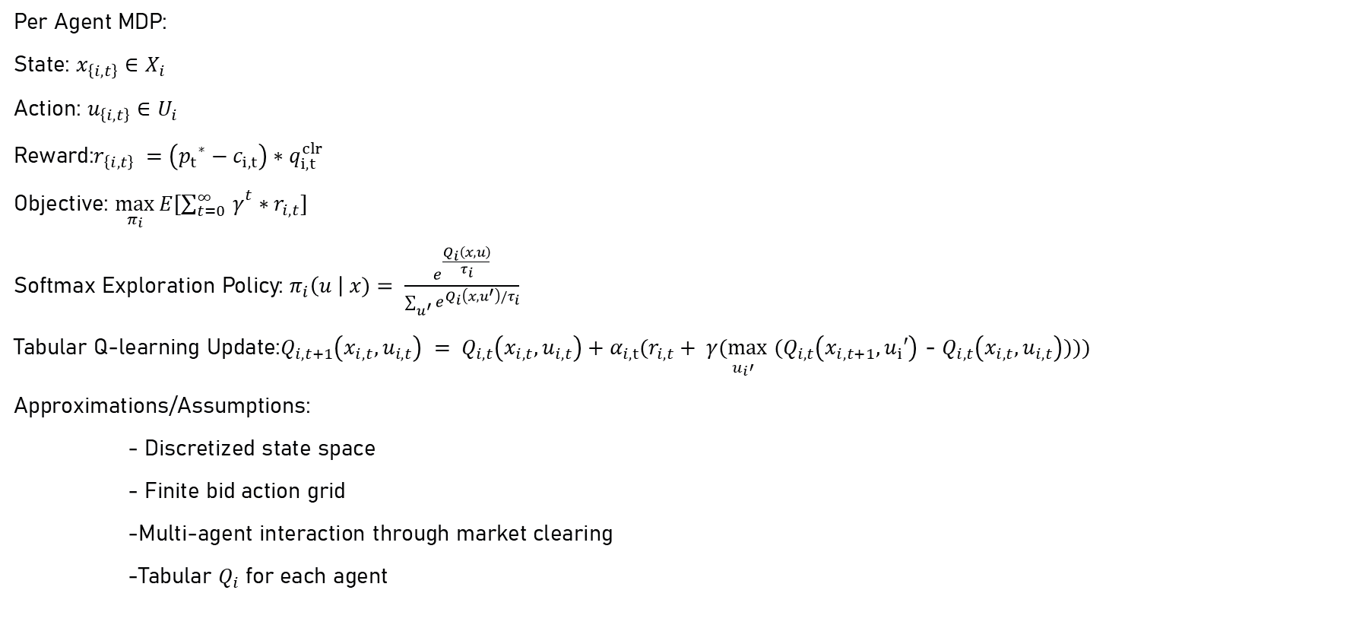
Mathematical Framework
Per Agent MDP:
State: $x_{\left\{i,t\right\}}∈X_{i}$
Action: $u_{\left\{i,t\right\}}∈U_{i}$
Reward:$r_{\left\{i,t\right\}} =\left({p_{t}}^{∗}−c_{i,t}\right)∗q_{i,t}^{clr}$
Objective: $\max_{π_{i}}{E[{\sum_{t=0 }^{∞}{γ}}^{t}∗r_{i,t}]}$
Softmax Exploration Policy: $π_{i}\left(u \right| x)= \frac{e^{\frac{Q_{i}\left(x,u\right)}{τ_{i}}}}{\sum_{u^{′}}{e^{Q_{i}\left(x, u^{′}\right)/τ_{i}}}}$
Tabular Q-learning Update:$Q_{i,t+1}\left(x_{i,t}, u_{i,t}\right) = Q_{i,t}\left(x_{i,t}, u_{i,t}\right)+α_{i,t}(r_{i,t}+ γ\underset{u_{i}′}{(max}$ ${(Q}_{i,t}\left(x_{i,t+1}, u_{i}′\right)$ - $Q_{i,t}\left(x_{i,t}, u_{i,t}\right))))$
Approximations/Assumptions:
- Discretized state space
- Finite bid action grid
-Multi-agent interaction through market clearing
-Tabular $Q_{i}$ for each agent
Notes:
Now let's walk through the mathematical framework underlying our model.
We formulate the problem as a per-agent Markov Decision Process.
Just as a heads up, a subscript i means the variable is agent specific, and a subscript t means a variable is time indexed.
Each agent i observes a state little x, drawn from a state space big X, and selects an action little u from an admissible action set big U.
The reward each agent receives is the profit from that hour which is simply the market clearing price minus the agent's marginal cost, multiplied by the quantity cleared.
Each agent's objective is to find a policy that maximizes their long-run expected discounted reward, where gamma is the discount factor.
To balance exploration and exploitation during training, we use the Boltzmann exploration policy. This converts Q-values into action probabilities using a temperature parameter tau. when tau is large, the agent explores more, and as it decays, the agent becomes more greedy.
The Q-table is updated at each step using the tabular Q-learning update rule. The new Q value for state x and action u equals the old Q value, plus a learning rate times the observed reward plus the discounted best future Q value, minus the current Q value.
Now, lets discuss 4 approximations and assumptions. First, we discretize the state space because variables like price and load are continuous in reality, but we bin them into a finite number of categories so that tabular Q-learning is feasible.
Second, we use a finite action grid, once again in reality price and quantity are continuous, but we bin them, which keeps the action space finite.
Third, we model multi-agent interaction through market clearing, agents don't model each other directly, but instead compete implicitly through the shared market outcome.
And fourth, each agent maintains its own tabular Q table, agents learn independently, without sharing information, which mirrors how real market participants operate.

Slide 11
Simulation Environment
Python based
Built on historical data
  LMP (market clearing price)
  Load (demand)
Built on forecasted data
  Load (demand)
  Forecasted load drives forecasted LMP
Notes:
We implemented our model in Python using a custom simulator which uses both historical and forecasted ERCOT data. Our RL agents observe a state based on the previous and a forecasted load, as well as some price information, and then submit their hourly price-quantity bids into a simulated market.

Slide 12
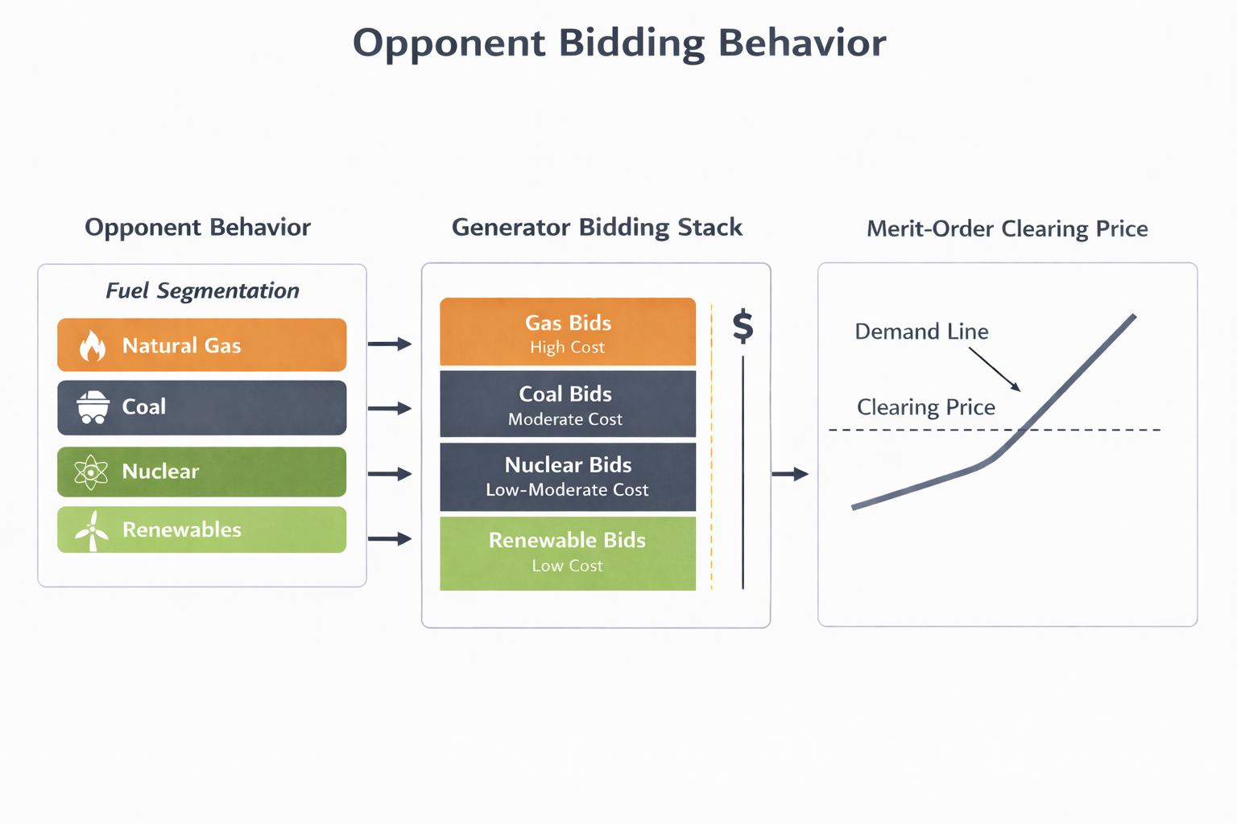
Simulation Environment
Notes:
To simulate competition, we use a time-indexed historical fuel mix dataset alongside the number of actual power generators there were to segment the historical supply stack. Within each segment, we sample from a Gaussian curve a price for each opponent. The quantity of their bid is proportional to the power generators size relative to the other generators in their fuel segment. We thus generate a merit-order list of bids to determine which of our RL agents would have cleared the market historically. This gives us a controllable environment to run various simulations, albeit with some non-trivial simplifications of real-market behavior.

Slide 13
Model Limitations
What We Assumed | Why We Assumed This | What This Breaks
Discretized state/action space | Allows for tabular Q-Learning | Reduced bidding options
Feasibility restrictions on actions | Enforces agent’s make “safe” bids | Biases learning
Fuel-based opponent model | Scalable/interchangeable competitor simulation | Limited strategic realism
Uniform-price hourly clearing | Simpler market simulation | Reduces some of the intricacies of market
Opponent bids sampled from Gaussian distribution (within fuel band) | Needed stochastic way to generate heterogeneous bids | Shape of opponent bids is assumed, not inferred
Marginal cost modeled via Henry Hub gas price distribution | Data grounded proxy for natural gas marginal cost | Captures fuel cost variation, but ignores plant-specific costs
Notes:
There were several assumptions we made in the interest of making the problem tractable. Firstly, we discretized the state space price components into a hyperparameter number of bins, and agents choose from a discrete set of prices for their bids. This makes tabular Q-learning feasible, but limits learned bidding strategies. Moreover, we capped the bid quantity of each RL agent, and forced their actions into what we considered a feasible region. This helped force the agents into making safe bids as if they were real market participants, but obviously distorts the agents’ learning. In terms of the market simulation, we just assume a merit order uniform-price auction that clears hourly. This captures the core pricing component of the game, but ignores transmission and congestion constraints market participants deal with in real life. In terms of simulating opponent behavior, we group generators by their fuel type and then construct bids by sampling a Gaussian distribution within their fuel band. This gives us variability across our opponents, but this distribution is not calibrated via real data. Lastly, we modeled our agents’ marginal cost using a Henry Hub-based natural gas price distribution. This provides a real stochastic data driven signal for cost, but does not capture plant-specific costs, such as heat rate for example. Overall, these assumptions allows for us to build a feasible simulation that captures the core components of the real life game, but the results have to be interpreted within the scope of the modeled environment.

Slide 14
Results

Slide 15
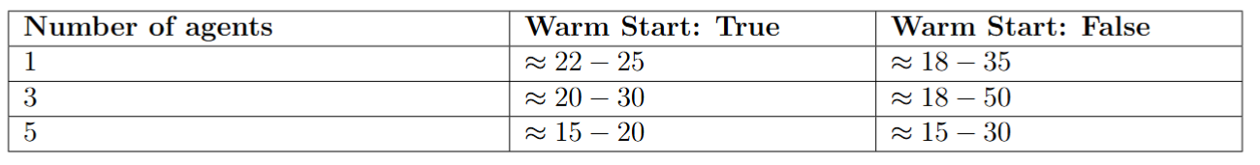
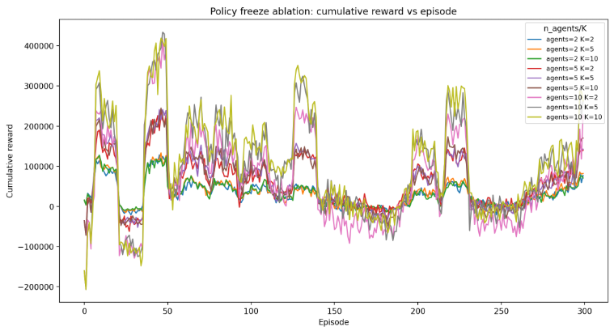
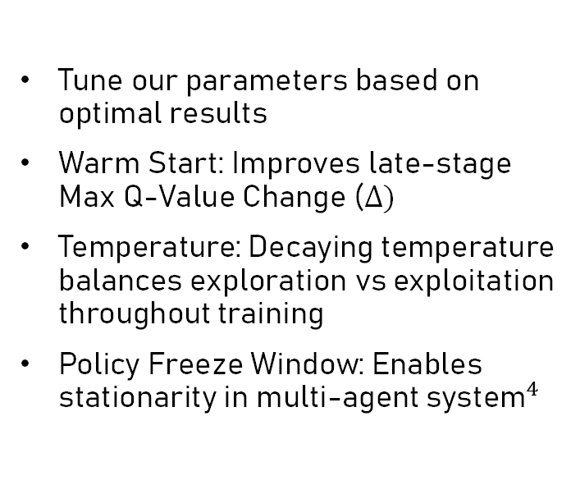
Parameter Selection
Tune our parameters based on optimal results
Warm Start: Improves late-stage Max Q-Value Change ($∆)$
Temperature: Decaying temperature balances exploration vs exploitation throughout training
Policy Freeze Window: Enables stationarity in multi-agent ${\text{system}}^{4}$
Table 1: Range of last five-episode Max Q-Value Change ($∆)$
Notes:
The simulation involved tuning parameters relating to learning, temperature, risk, and __.

Slide 16
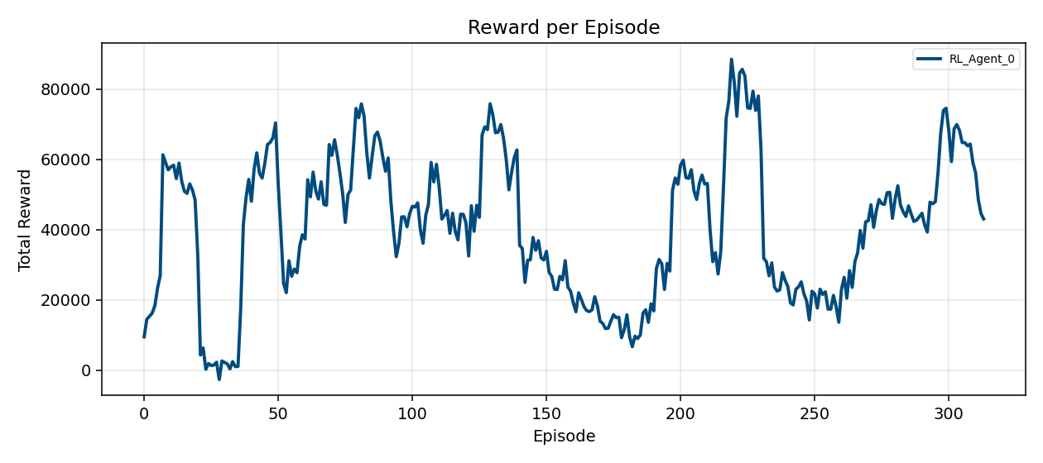
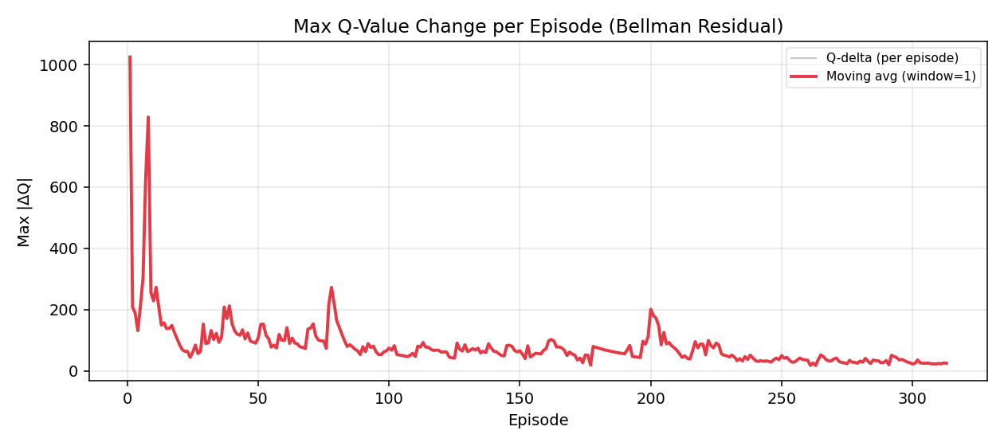
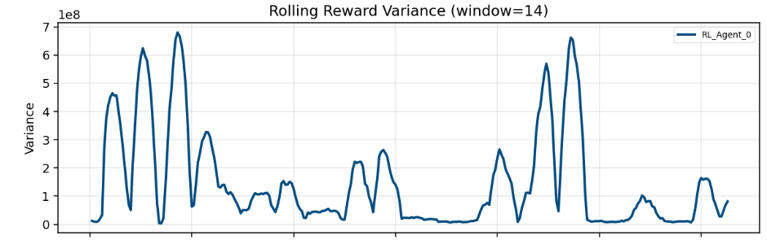

Training - 1 agent
Reward per Episode
Max Q-Value Change ($∆)$per episode
Notes:
Training results and convergence. Say nothing about optimality here, that is later. Converging to a policy.

Slide 17
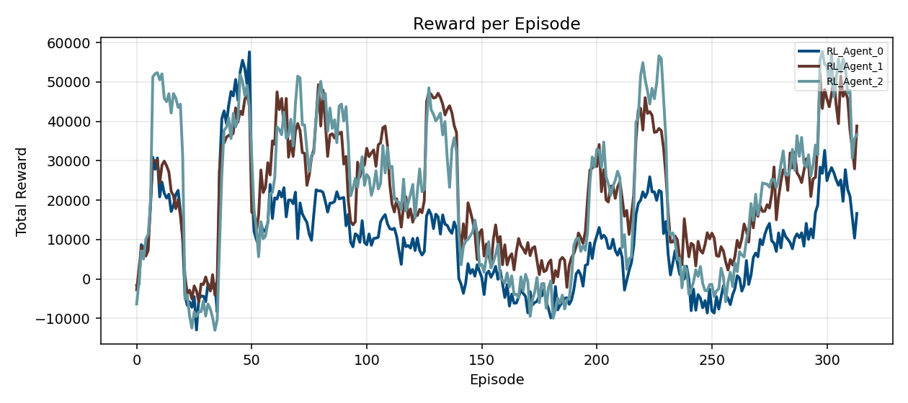
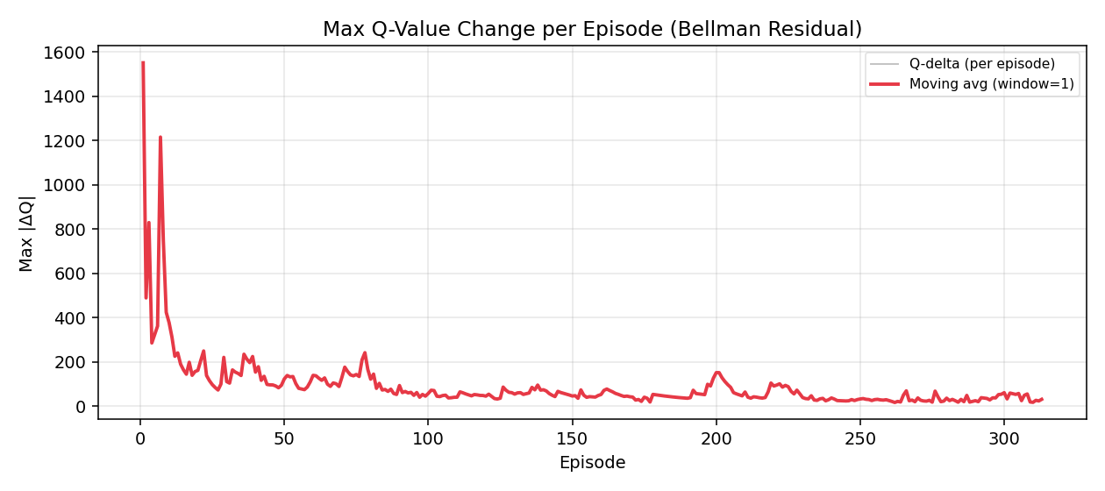
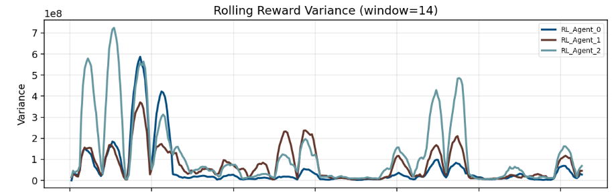

Training – 3 agents
Reward per Episode
Max Q-Value Change ($∆)$per episode
Notes:
Training results and convergence. Say nothing about optimality here, that is later. Converging to a policy.

Slide 18
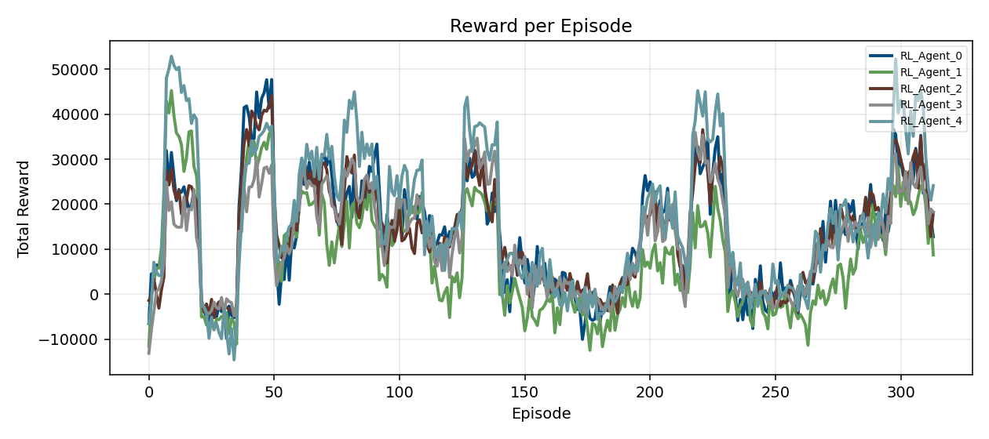
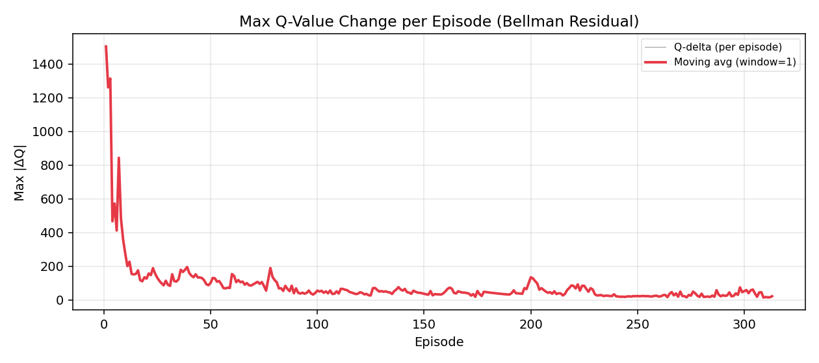
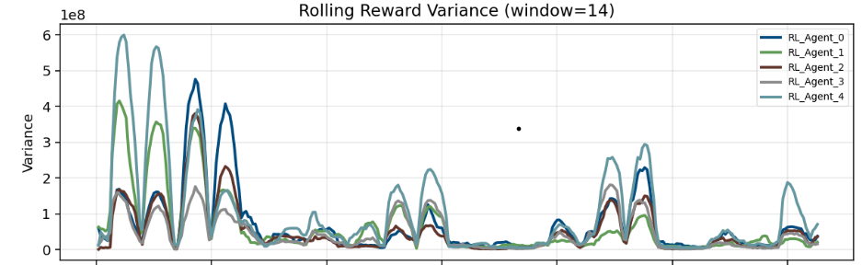

Training – 5 agents
Reward per Episode
Max Q-Value Change ($∆)$per episode
Notes:
Training results and convergence. Say nothing about optimality here, that is later. Converging to a policy.

Slide 19
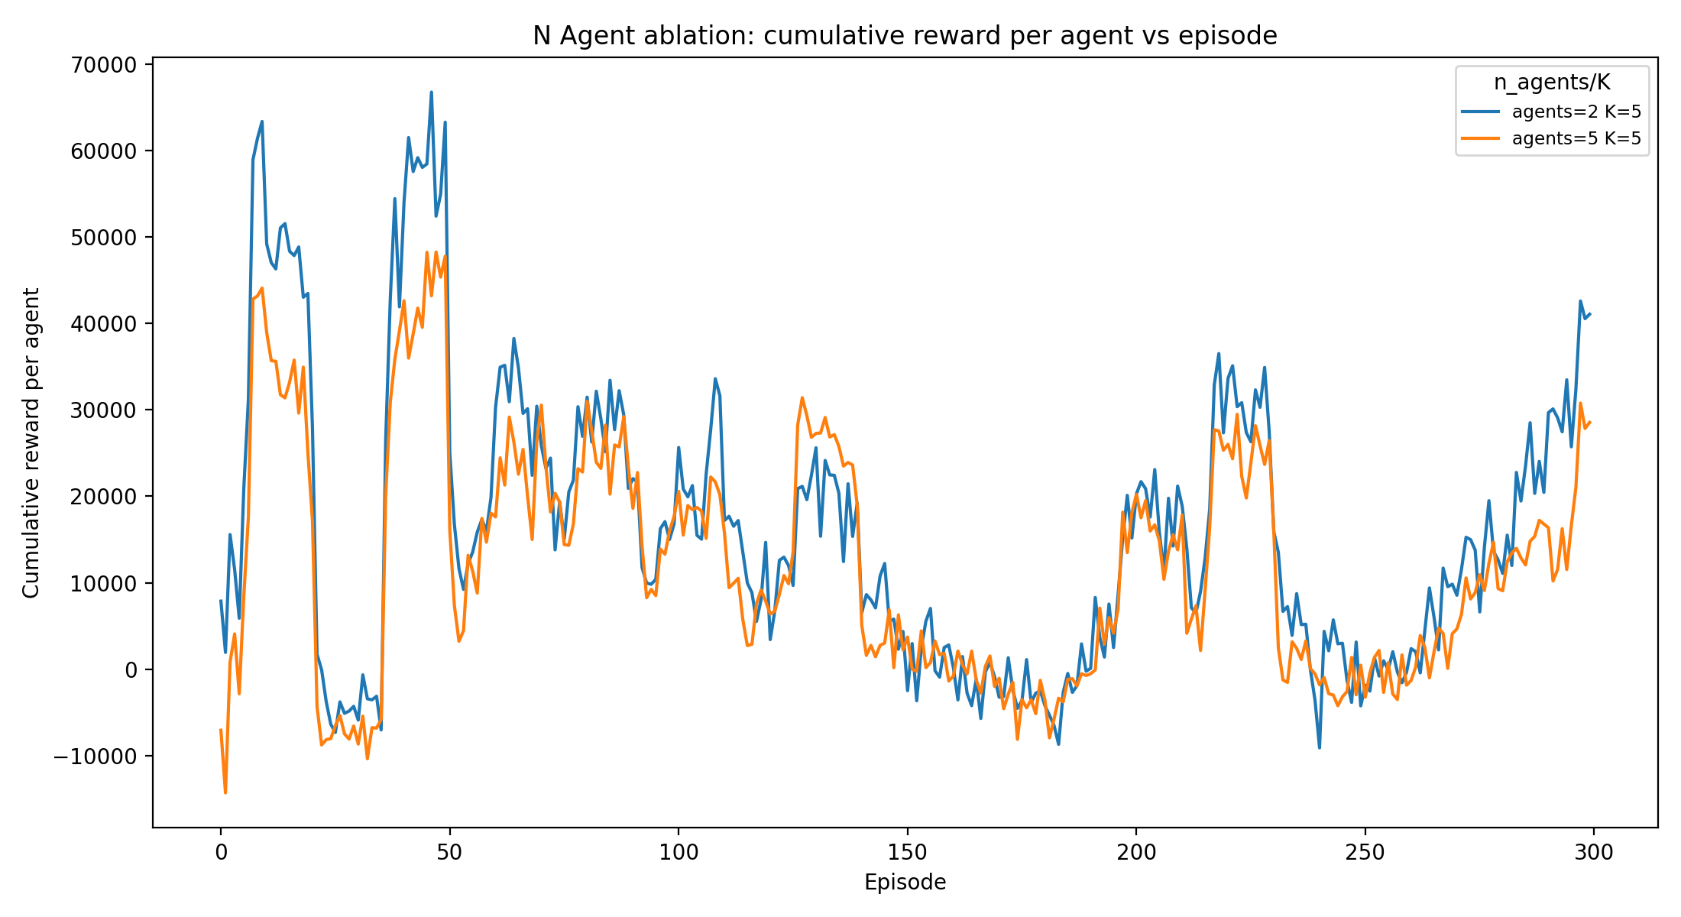
Sensitivity Analysis
Cumulative reward per agent decreases as number of agents increases

Slide 20
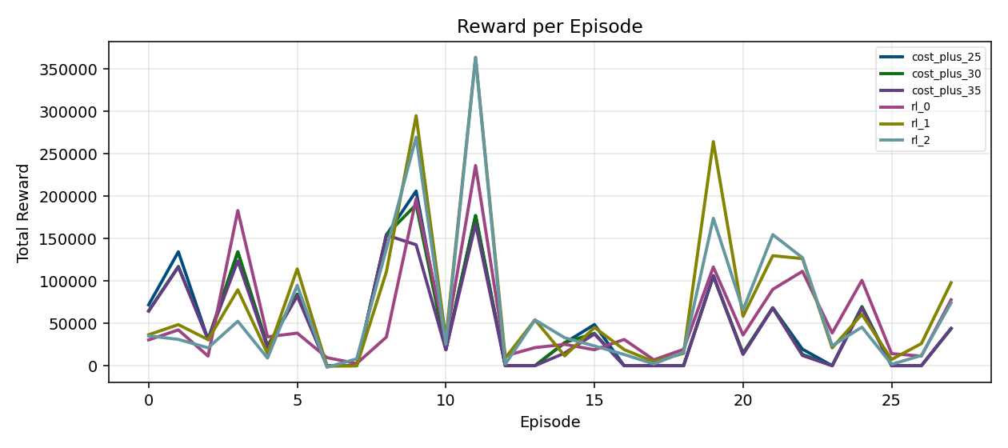
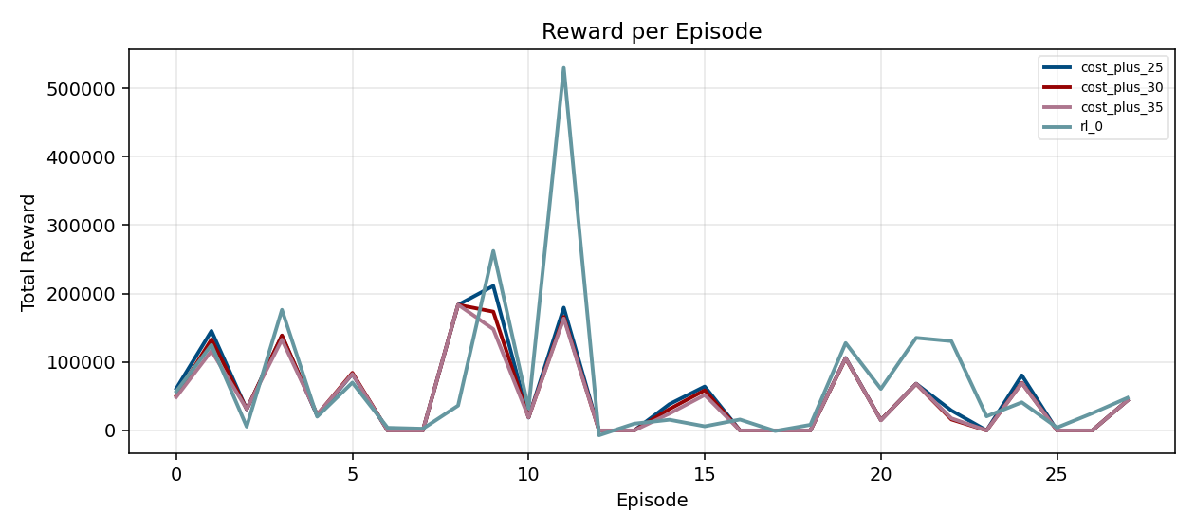
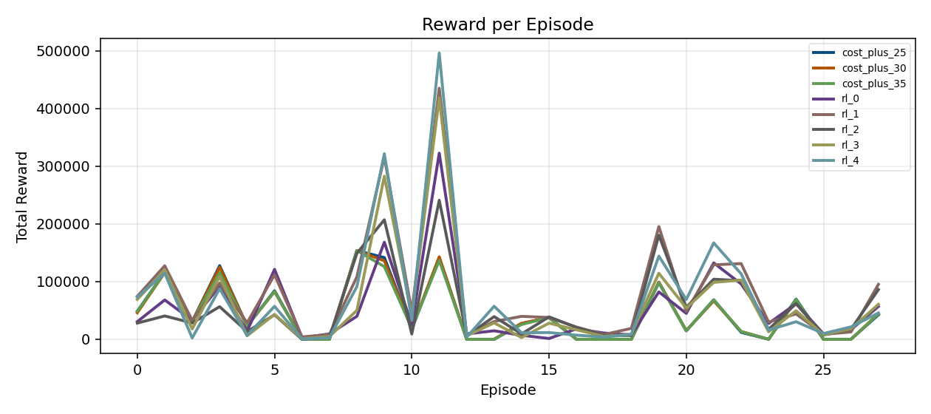
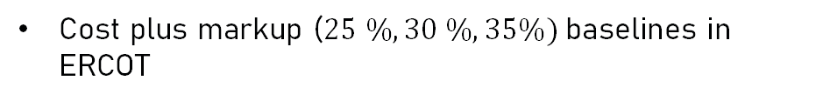
Baselines
Cost plus markup ($25 \%, 30 \%, 35\%)$baselines in ERCOT

Slide 21
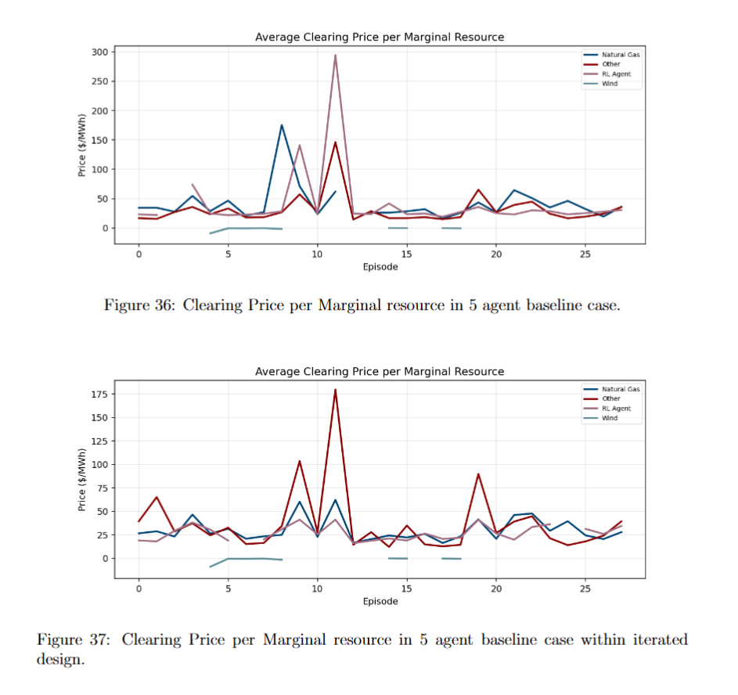
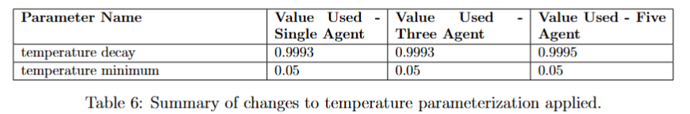
Design Improvements
Dataset Expansion
Parameter Selection Changes
Convergence Threshold Modifications
In-Sample Baselines

Slide 22
Validation

Slide 23
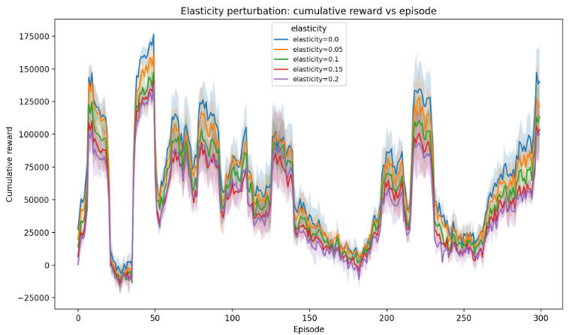
Elasticity Perturbation
Elasticity: Demand sensitivity to change in price
  Reward decreases as elasticity increases

Slide 24
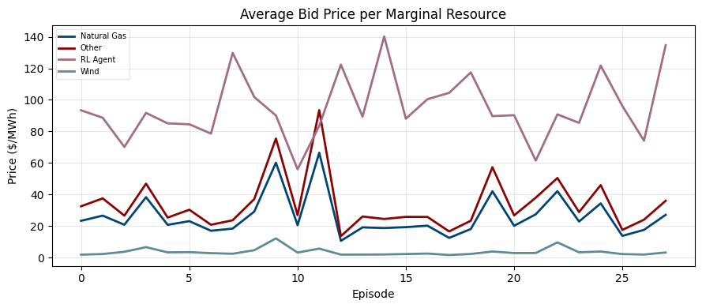
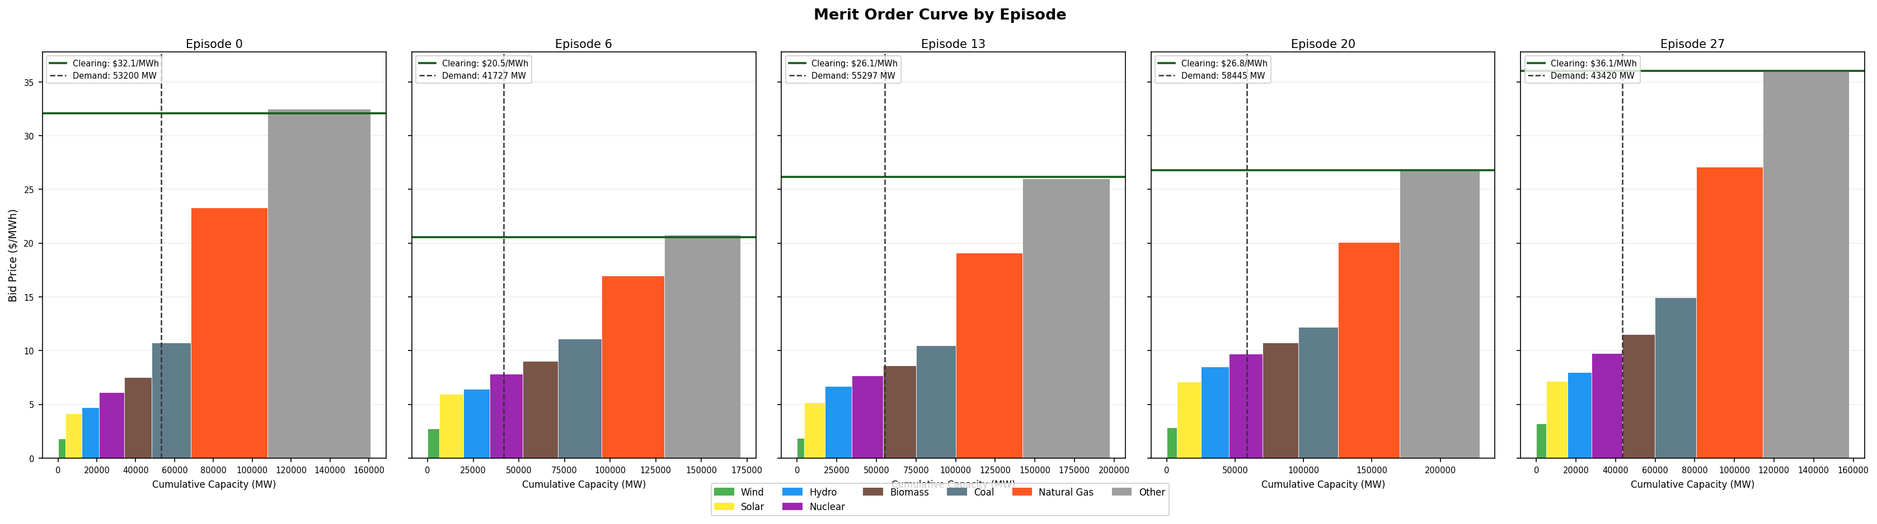
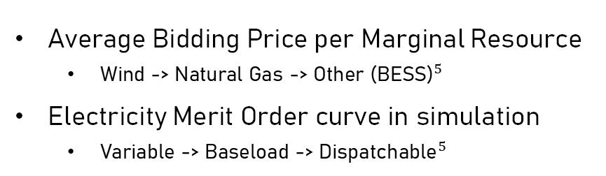
Market simulation validity
Average Bidding Price per Marginal Resource
  Wind -> Natural Gas -> Other ${\text{(}\text{BESS}\text{)}}^{5}$
Electricity Merit Order curve in simulation
  Variable -> Baseload -> ${\text{Dispatchable}}^{5}$
Notes:
Tracks actual market; Everything is proxied off of real data, so this makes sense.

Slide 25
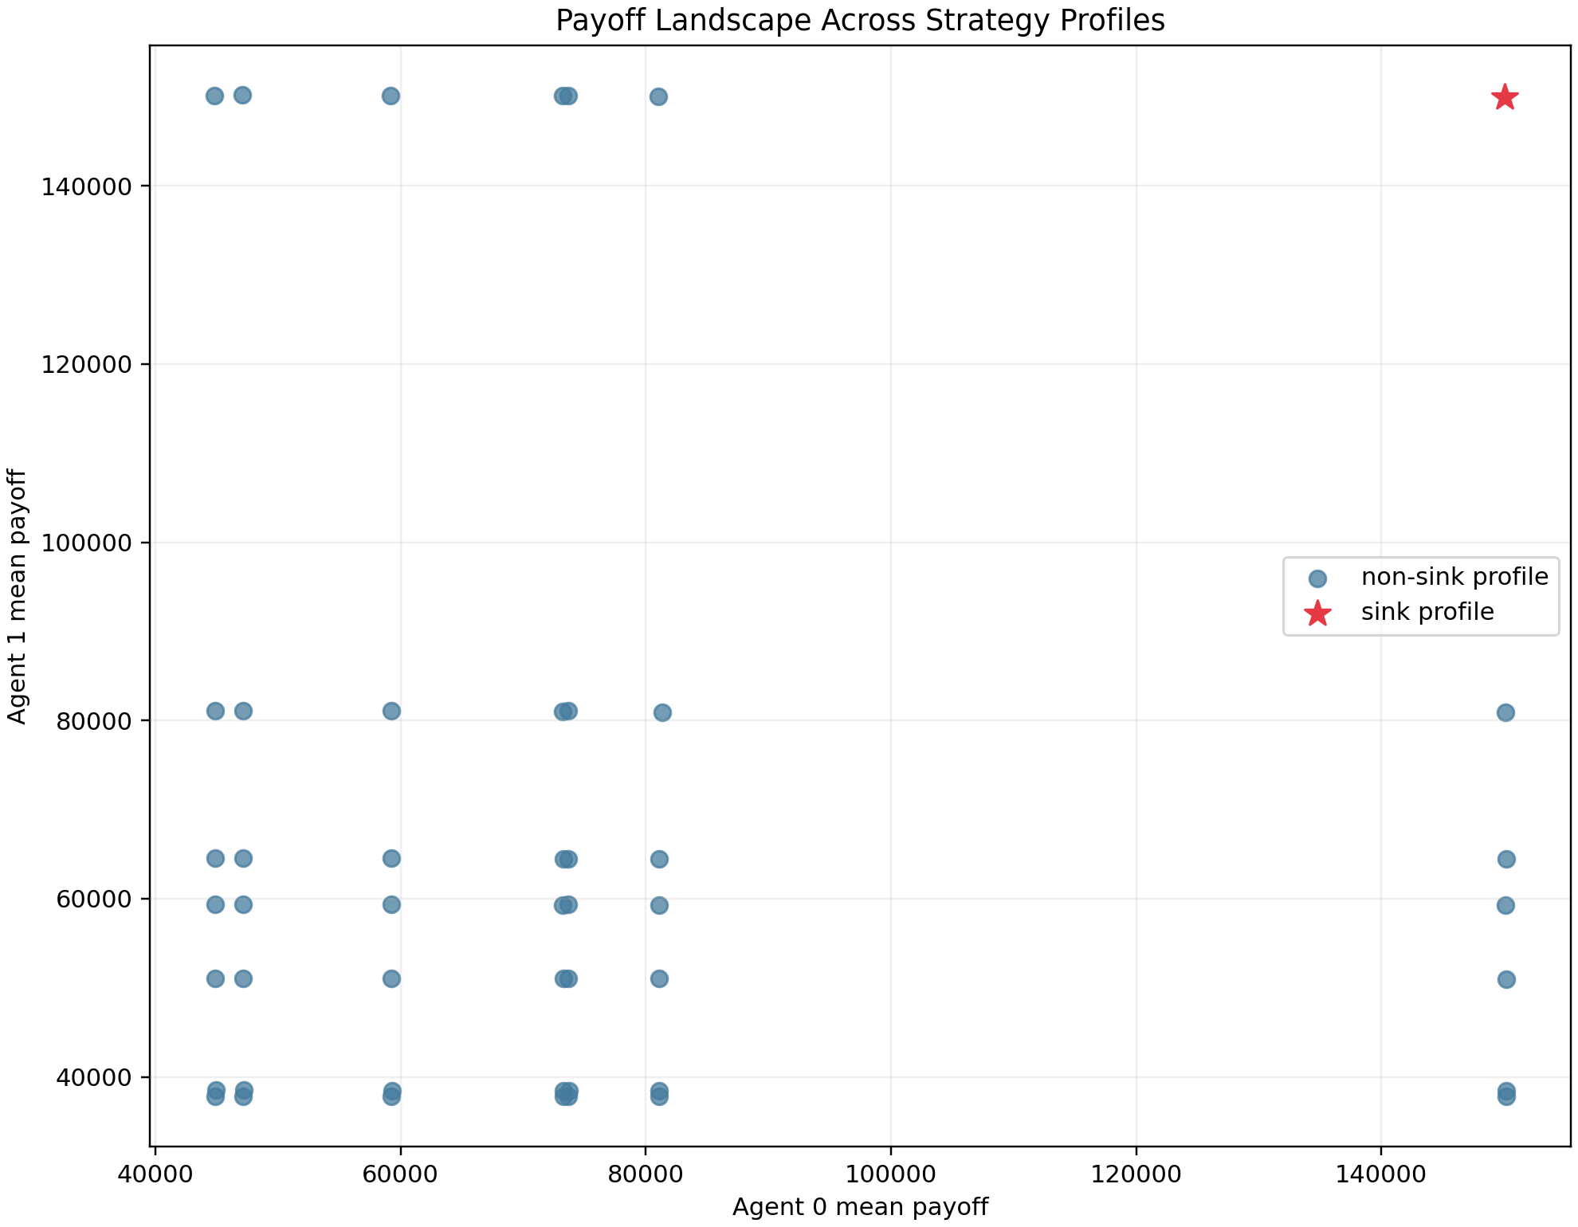
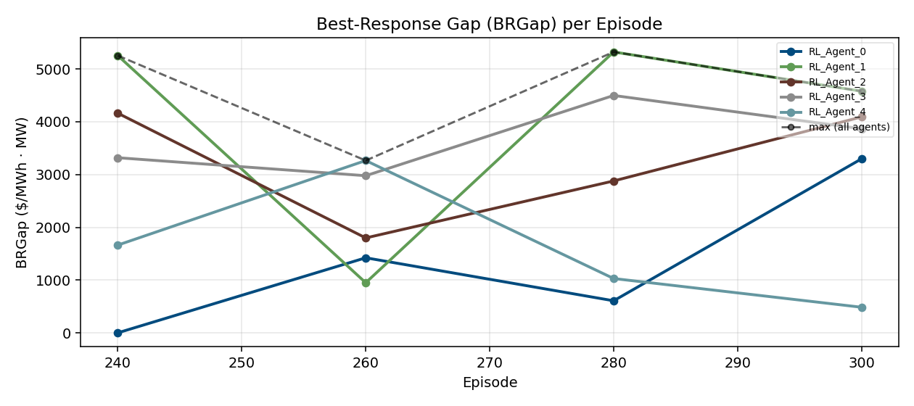

Optimality and Convergence
Weak Acyclicity: Verification of convergence paths in sink ${\text{profile}}^{4}$
Late-Stage Policy: Optimality vs randomized seeded policies during training
Notes:
Proved that the graph is weakly acyclic on a small subset of the game: The graphs show that the overall game is weakly acyclic.
Middle graph: Cycling through actions, they need to reach a cycle of the same agents. Need a repeated set of actions.
BRGap (Not included): 2 agent case, action set on y-axis, split on agent 1 and 2. Explain what results mean (Green good, red is bad)
Bottom left graph (Maybe): Best Response Gap during training, showing that the Best Response Gap has not closed on multi-agent case. However, the implications in the next slide show something else.

Slide 26
Implications

Slide 27
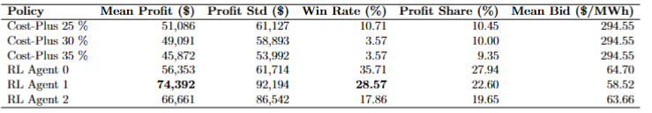
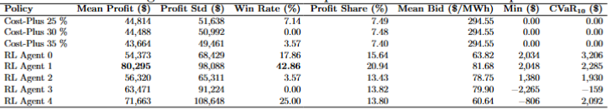
Baseline Implications
Power Generator Bidding:
  Learning vs non-learning strategy
  Iterated design has no dominant agent; Less aggressive bidding.
Market mechanism:
  Mean Profit, Win Rate, and Mean Bid
Table 2: Three agent case, with undercutting strategy is most dominant.
Table 3: Five agent Case, with more sophisticated strategy tracking marginal resource.
Notes:
Power Generator: Learning vs non-learning bidder contrastion. In the single agent case, a sophisticated strategy beats out a basic one.
Market Mechanism: Win Rate statistic (Explain it) – For bidders with the same action space, the advantage is in the sophistication of the bidding strategy. As more agents are added, the minimum bar for sophistication amongst all agents. Looking at the top agents in the 3 and 5 agent cases, the strategy shifts from a simple undercutting strategy to a more complicated strategy where it is trying to get the marginal cost.
Even the agents with no win rate are capturing two the profit share then the best cost plus markup.

Slide 28
Closing Thoughts

Slide 29
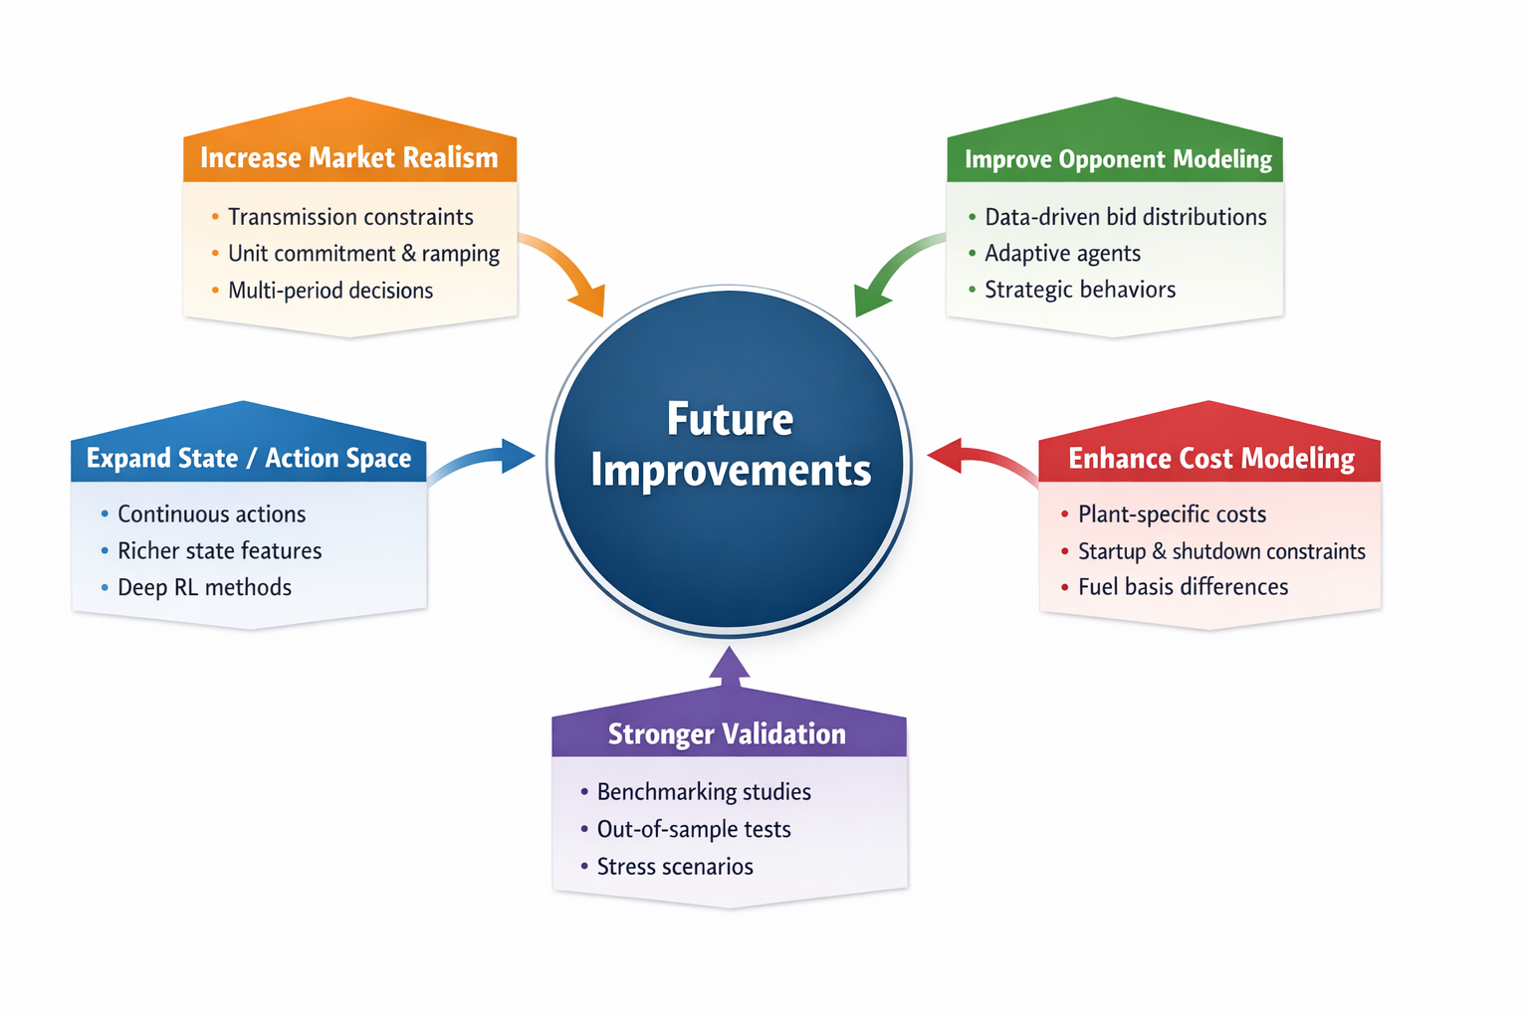
Design Improvements
Notes:
There are a few clear next steps for the model.
Firstly, we would like to incorporate realism constraints like power congesting and ramping into our market clearing simulation.
Secondly, we would like to switch from using a Gaussian distribution to sample opponent bids to instead using some form of data-proxied distribution.
Thirdly, we think the model performance would improve by in tandem increasing the state space to explicitly incorporate things such as weather and using a DQN to handle this increased dimensionality.
Fourthly, we would move to more realistic marginal costs via plant-specific cost curves, heat rates and operational constraints.
Lastly, we would strengthen the validation of our model’s performance by benchmarking more rigoursly against both historical data and stress scenarios.

Slide 30
References

Slide 31
[1] I. N. England, “How resources are selected and prices are set in the wholesale energy markets,” How Resources Are Selected and Prices Are Set in the Wholesale Energy Markets, https://www.iso-ne.com/about/what-we-do/how-resources-are-selected-and-prices-are-set (accessed Oct. 30, 2025).
[2] “Energy,” ISO, https://www.iso.org/foresight/energy.html (accessed Feb. 21, 2026).
[3] “Creating the future of energy together.,” Enverus, https://www.enverus.com/ (accessed Oct. 25, 2025).
[4] G. Arslan and S. Yuksel, “Decentralized Q-learning for stochastic teams and games,” IEEE Transactions on Automatic Control, vol. 62, no. 4, pp. 1545–1558, Apr. 2017, Accessed February 23rd, 2026. DOI: 10.1109/TAC.2016.2598476
[5] Potomac Economics, “2023 state of the market report for the ERCOT electricity markets,” Potomac Economics, Ltd. (Independent Market Monitor for ERCOT), Tech.Rep., 2024. [Online]. Available: https://www.potomaceconomics.com/wp-content/uploads/2024/06/2023-ERCOT-SOM-Report.pdf.

Slide 32
Appendix

Slide 33
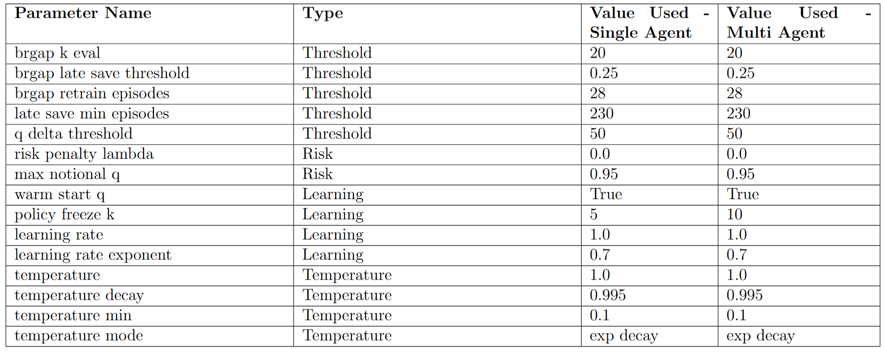
Parameter Selection Table

Slide 34



Warm Start
First last 25-episode Max Q-Value Change ($∆)$
Range of last 50-episode Max Q-Value Change ($∆)$
Variance of last 50-episode Max Q-Value Change ($∆)$

Slide 35

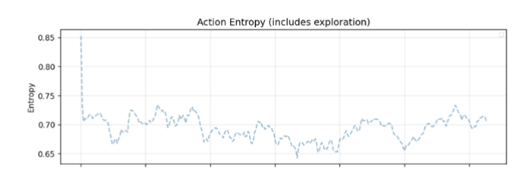
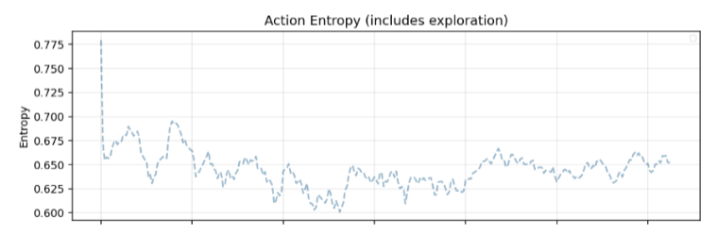
Temperature Schedule
Action Entropy in Single Agent Case, Fixed Decay.
Action Entropy in Single Agent Case, Exp. Decay

Slide 36
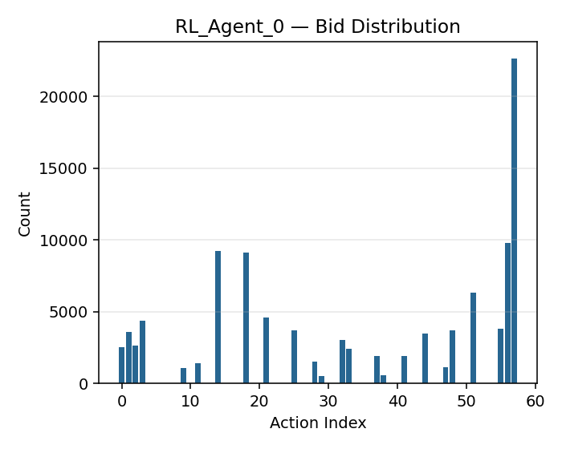
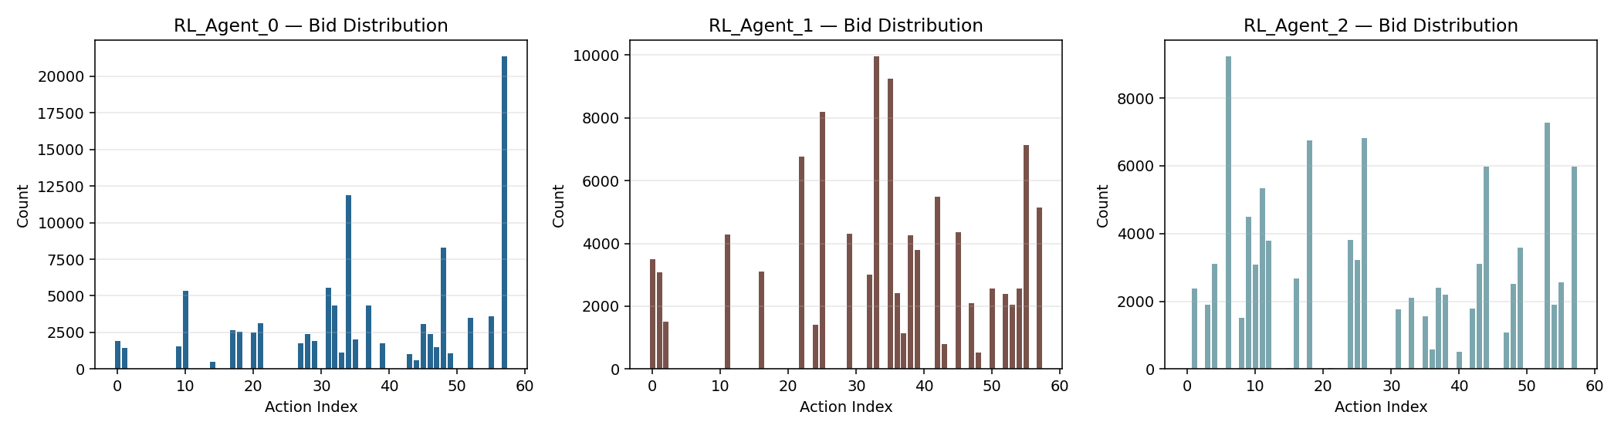
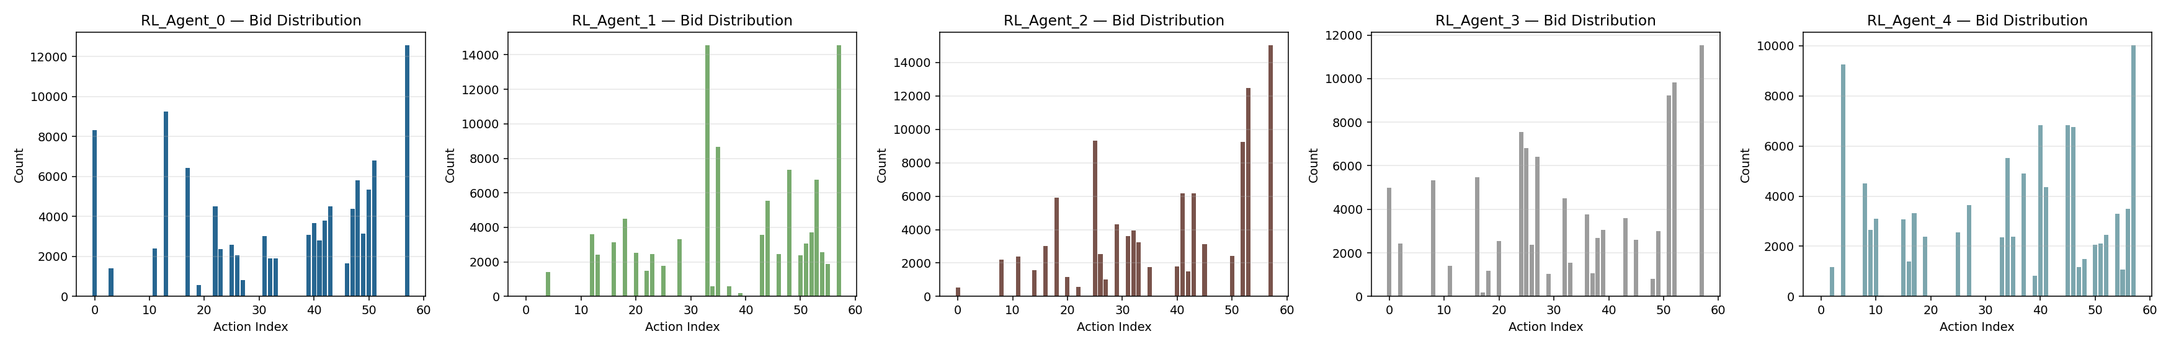
Training: Bid Distributions

Slide 37
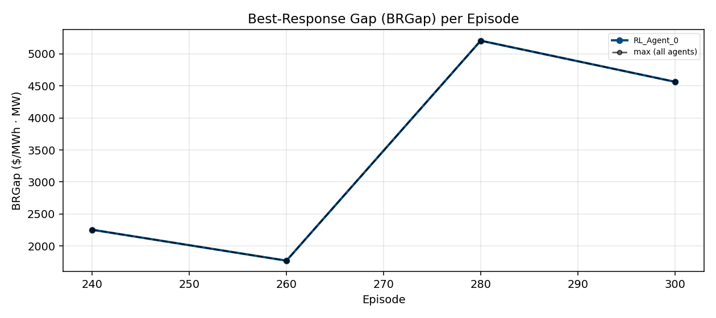
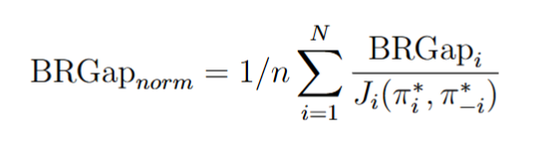
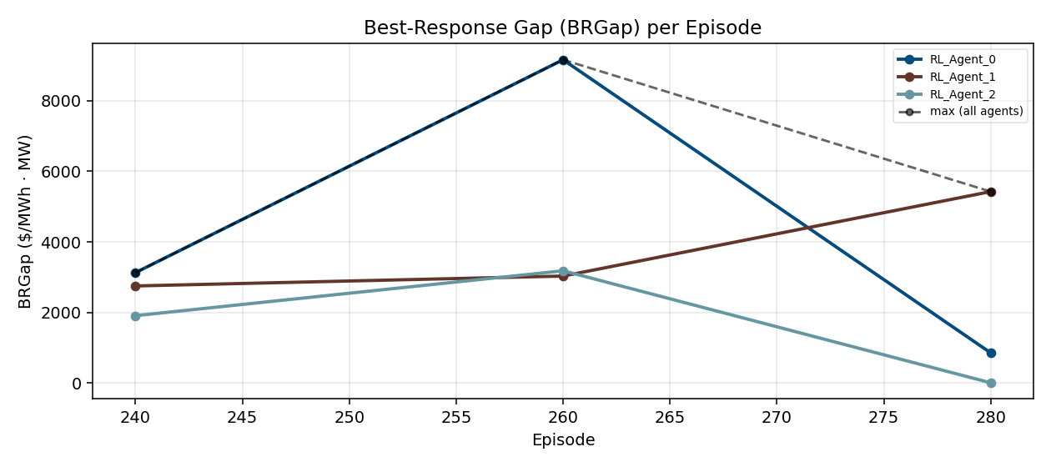
BRGap – 1, 3 agent case

Slide 38
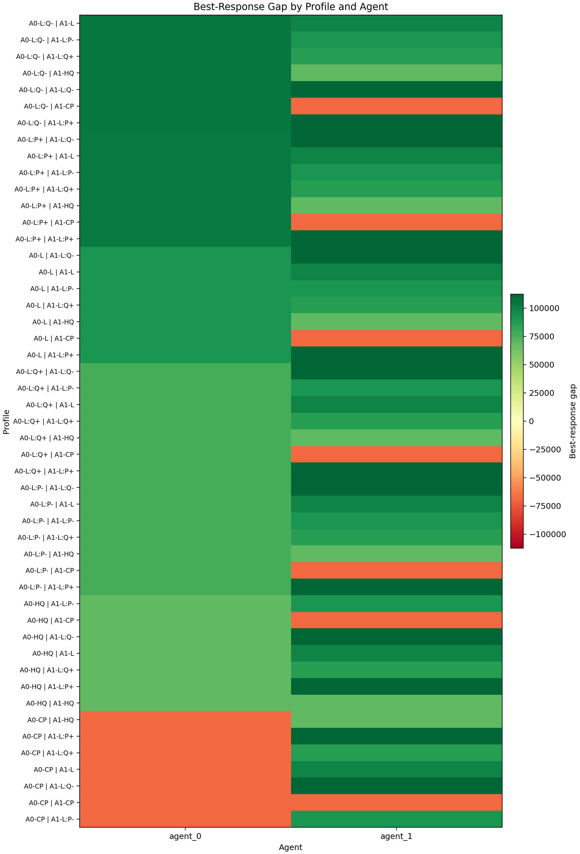
Weak Acyclicity: BRGap

Slide 39
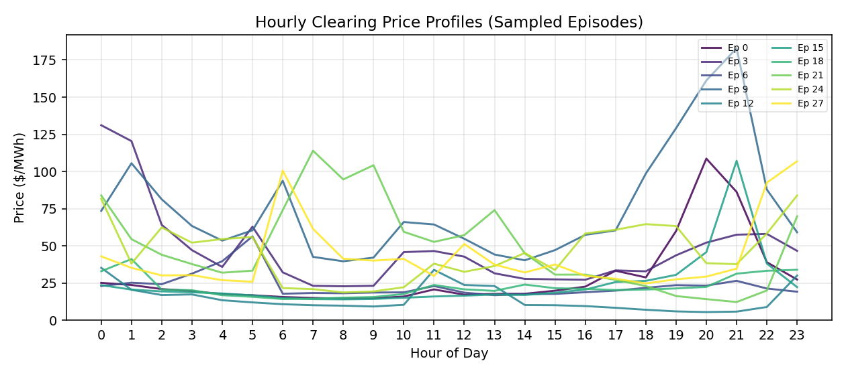
Hourly Clearing Prices – 5 agent case

Slide 40


More on Implications
Power Generator Strategy: Mean profit across each baseline
Market implications: RL Bid amount rebounds -> Bid Efficiency goes up -> Clearing goes down.

Slide 41


More on implications

